Slide 1

Digital Design
Chapter 1: Introduction
Slides to accompany the textbook Digital Design, First Edition,
by Frank Vahid, John Wiley and Sons Publishers, 2007.
http://www.ddvahid.com
Copyright © 2007 Frank Vahid
Instructors of courses requiring Vahid's Digital Design textbook (published by John Wiley and Sons) have permission to modify and use these slides for customary course-related activities, subject to keeping this copyright notice in place and unmodified. These slides may be posted as unanimated pdf versions on publicly-accessible course websites.. PowerPoint source (or pdf with animations) may not be posted to publicly-accessible websites, but may be posted for students on internal protected sites or distributed directly to students by other electronic means. Instructors may make printouts of the slides available to students for a reasonable photocopying charge, without incurring royalties. Any other use requires explicit permission. Instructors may obtain PowerPoint source or obtain special use permissions from Wiley – see http://www.ddvahid.com for information.

Slide 2

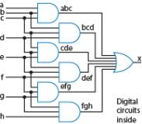
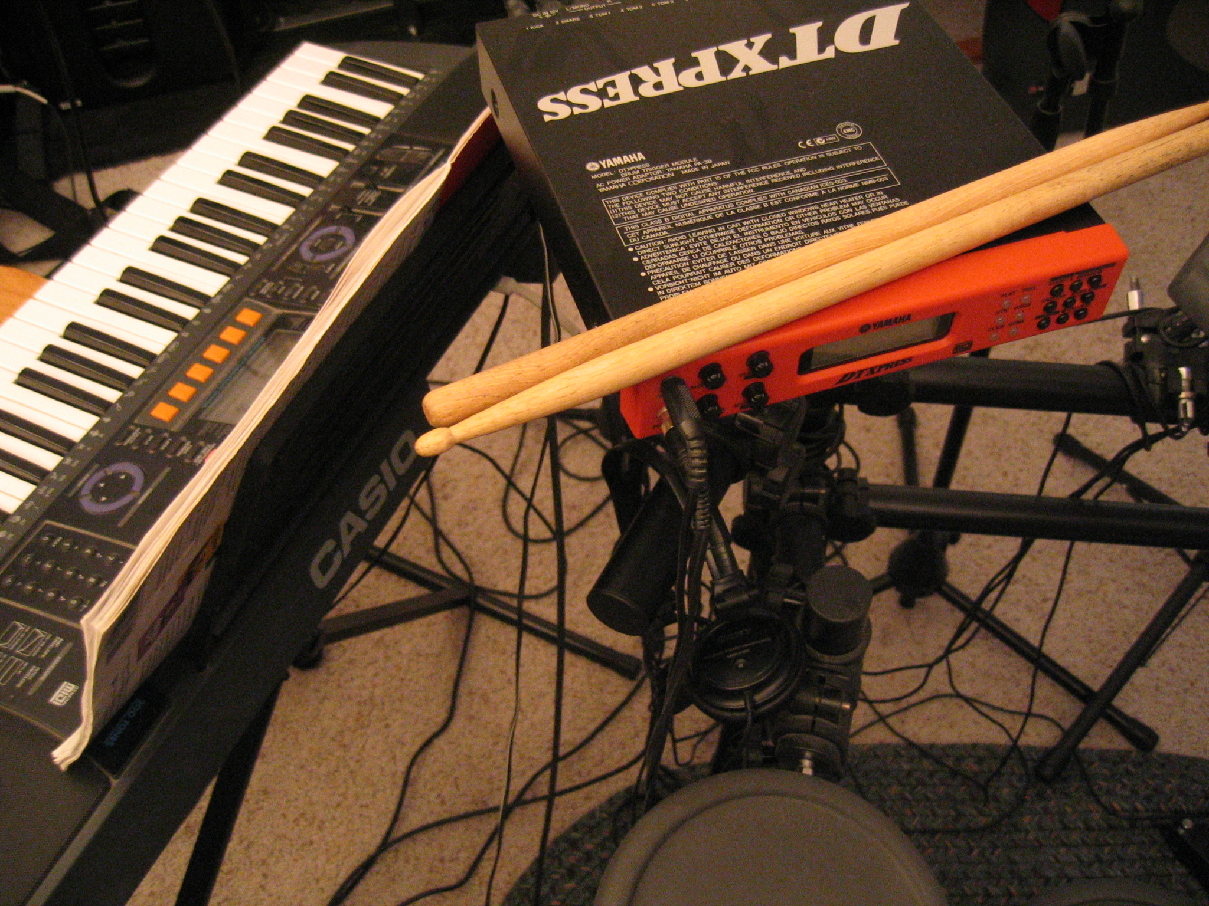

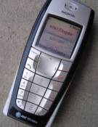
Why Study Digital Design?
1.1
Look “under the hood” of computers
  Solid understanding --> confidence, insight, even better programmer when aware of hardware resource issues
Electronic devices becoming digital
  Enabled by shrinking and more capable chips
  Enables:
    Better devices: Better sound recorders, cameras, cars, cell phones, medical devices,...
    New devices: Video games, PDAs, ...
  Known as “embedded systems”
    Thousands of new devices every year
    Designers needed: Potential career direction
Satellites
DVD
Video
Musical
Portable
players
recorders
instruments
music players
Cell phones
Cameras
TVs
???
1995
1997
1999
2001
2003
2005
2007
Years shown above indicate when digital version began to dominate
  (Not the first year that a digital version appeared)
Note: Slides with animation are denoted with a small red "a" near the animated items

Slide 3
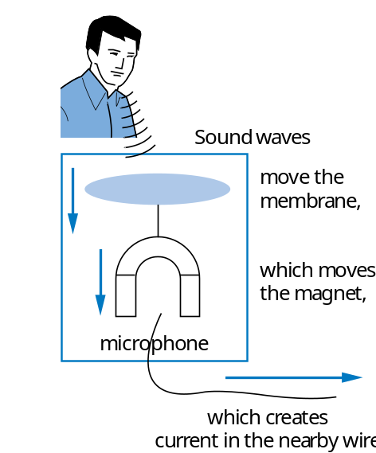
What Does “Digital” Mean?
1.2
Analog signal
  Infinite possible values
    Ex: voltage on a wire created by microphone
Digital signal
  Finite possible values
    Ex: button pressed on a keypad
1
2
3
4
2
digital
signal
analog
signal
Possible values:
1.00, 1.01, 2.0000009,
... infinite possibilities
Possible values:
0, 1, 2, 3, or 4.
That’s it.
4
value
value
3
2
1
0
time
time

Slide 4
Digital Signals with Only Two Values: Binary
Binary digital signal -- only two possible values
  Typically represented as 0 and 1
  One binary digit is a bit
  We’ll only consider binary digital signals
  Binary is popular because
    Transistors, the basic digital electric component, operate using two voltages (more in Ch. 2)
    Storing/transmitting one of two values is easier than three or more (e.g., loud beep or quiet beep, reflection or no reflection)
value
1
0
time

Slide 5
Example of Digitization Benefit
Analog signal (e.g., audio) may lose quality
  Voltage levels not saved/copied/transmitted perfectly
Digitized version enables near-perfect save/cpy/trn.
  “Sample” voltage at particular rate, save sample using bit encoding
  Voltage levels still not kept perfectly
  But we can distinguish 0s from 1s
3
3
Volts
2
2
lengthy transmission
(e.g, cell phone)
1
original signal
1
received signal
0
0
time
time
How fix -- higher, lower, ?
01
10
11
10
11
a2d
Volts
a
digitized signal
lengthy transmission
(e.g, cell phone)
1
1
0
0
time
time
Can fix -- easily distinguish 0s and 1s, restore
Let bit encoding be:
1 V: “01”
2 V: “10”
3 V: “11”
01
10
11
10
11
Digitized signal not
perfect re-creation,
but higher sampling
rate and more bits per
encoding brings closer.
d2a
same
3
Volts
2
1
0
time

Slide 6
Digitized Audio: Compression Benefit
Digitized audio can be compressed
  e.g., MP3s
  A CD can hold about 20 songs uncompressed, but about 200 compressed
Compression also done on digitized pictures (jpeg), movies (mpeg), and more
Digitization has many other benefits too
Example compression scheme:
00 --> 0000000000
01 --> 1111111111
    1X --> X
0000000000 0000000000 0000001111 1111111111
00 00 10000001111 01

Slide 7
How Do We Encode Data as Binary for Our Digital System?
analog
button
a
phenomena
Some inputs inherently binary
  Button: not pressed (0), pressed (1)
Some inputs inherently digital
  Just need encoding in binary
  e.g., multi-button input: encode red=001, blue=010, ...
Some inputs analog
  Need analog-to-digital conversion
  As done in earlier slide -- sample and encode with bits
0
1
sensors and
other inputs
r
ed
blue
g
r
een
black
electric
digital
signal
data
0
0
0
A2D
r
ed
blue
g
r
een
black
digital
data
0
0
1
Digital System
r
ed
blue
g
r
een
black
digital
digital
0
1
0
data
data
33 degrees
D2A
air
electric
signal
temperature
actuators and
sensor
other outputs
0
0
1
0
0
0
0
1

Slide 8
How to Encode Text: ASCII, Unicode
ASCII: 7- (or 8-) bit encoding of each letter, number, or symbol
Unicode: Increasingly popular 16-bit bit encoding
  Encodes characters from various world languages
S
ymbol
En
c
oding
S
ymbol
En
c
oding
R
1010010
r
1110010
S
1010011
s
1110011
T
1010100
t
1110100
L
1001100
l
1101100
N
1001110
n
1101110
E
1000101
e
1100101
0
0110000
9
0111001
.
0101110
!
0100001
<tab>
0001001
<spa
c
e>
0100000
Question:
What does this ASCII bit sequence represent?
1010010 1000101 1010011 1010100
R E S T

Slide 9
How to Encode Numbers: Binary Numbers
Each position represents a quantity; symbol in position means how many of that quantity
  Base ten (decimal)
    Ten symbols: 0, 1, 2, ..., 8, and 9
    More than 9 -- next position
      So each position power of 10
    Nothing special about base 10 -- used because we have 10 fingers
  Base two (binary)
    Two symbols: 0 and 1
    More than 1 -- next position
      So each position power of 2
5
2
3
10
4
10
3
10
2
10
1
10
0
1
0
1
Q: How much?
4
3
2
1
0
+
=
2
2
2
2
2
a
4
+
1
=
5

Slide 10
How to Encode Numbers: Binary Numbers
Working with binary numbers
  In base ten, helps to know powers of 10
    one, ten, hundred, thousand, ten thousand, ...
  In base two, helps to know powers of 2
    one, two, four, eight, sixteen, thirty two, sixty four, one hundred twenty eight
      (Note: unlike base ten, we don’t have common names, like “thousand,” for each position in base ten -- so we use the base ten name)
    Q: count up by powers of two
2
9
2
8
2
7
2
6
2
5
2
4
2
3
2
2
2
1
2
0
512
256
128
64
32
16
8
4
2
1
512
256
128
64
32
16
8
4
2
1
a

Slide 11
Converting from Decimal to Binary Numbers: Subtraction Method (Easy for Humans)
Goal
  Get the binary weights to add up to the decimal quantity
    Work from left to right
    (Right to left – may fill in 1s that shouldn’t have been there – try it).
Desired decimal number: 12
32
16
8
4
2
1
1
=32
too much
32
16
8
4
2
1
0
1
=16
too much
32
16
8
4
2
1
a
0
0
1
=8
ok, keep going
32
16
8
4
2
1
0
0
1
1
=8+4=12
DONE
32
16
8
4
2
1
0
0
1
1
0
0
answer
32
16
8
4
2
1

Slide 12
Converting from Decimal to Binary Numbers: Subtraction Method (Easy for Humans)
Subtraction method
  To make the job easier (especially for big numbers), we can just subtract a selected binary weight from the (remaining) quantity
    Then, we have a new remaining quantity, and we start again (from the present binary position)
    Stop when remaining quantity is 0
Remaining quantity: 12
32
16
8
4
2
1
1
32 is
too much
32
16
8
4
2
1
0
1
16 is
too much
32
16
8
4
2
1
a
0
0
1
12 – 8 = 4
32
16
8
4
2
1
0
0
1
1
4-4=0
DONE
32
16
8
4
2
1
0
0
1
1
0
0
answer
32
16
8
4
2
1

Slide 13
Converting from Decimal to Binary Numbers:
Subtraction Method Example
Q: Convert the number “23” from decimal to binary
A: Remaining quantity
Binary Number
23
0
0
0
0
0
0
32
16
8
4
2
1
23
0
1
0
0
0
0
-16
32
16
8
4
2
1
a
7
7
0
1
0
1
0
0
-4
32
16
8
4
2
1
3
8 is more than 7, can’t use
4
0
1
0
1
1
0
-2
32
16
8
4
2
1
1
1
0
1
0
1
1
1
-1
32
16
8
4
2
1
0
Done! 23 in decimal is 10111 in binary.
D
ecimal
Bina
r
y
1.
ut 1 in highest pla
P
c
e
23
1
0
0
0
0
(cu
r
r
e
n
t
v
alue
P
la
c
e 32
t
oo bi
g
, but 16
w
o
r
k
s
.
–16
16
8
4
2
1
is 16)
2. Upd
a
t
D
e decimal number
7
ecimal not
z
e
r
o
,
r
etu
r
n
t
o
S
t
ep 1
1.
ut 1 in highest pla
1
0
1
0
0
(cu
r
r
e
n
t
v
alue
P
c
e
is 20)
N
e
x
t pla
c
e is 8,
t
4
oo big (8>7)
16
8
4
2
1
2. Upd
a
w
o
r
ks (4<7)
–4
t
e decimal number
3
ecimal number not
D
z
e
r
o
,
r
t
o
S
t
ep 1
etu
r
n
1.
ut 1 in highest pla
1
0
1
1
0
(cu
r
r
e
n
t
v
alue
P
c
e
16
8
4
2
1
is 22)
N
2. Upd
e
x
t pla
c
e is 2,
w
o
r
ks (2<3)
–2
a
t
D
e decimal number
1
ecimal not
z
e
r
o
,
r
etu
r
n
t
o
S
t
ep 1
1.
ut 1 in highest pla
1
0
1
1
1
(cu
r
r
e
n
t
v
alue
P
c
e
16
8
4
2
1
is 23)
N
2. Upd
e
x
t pla
c
e is 1,
w
o
r
ks (1=1)
–1
a
t
D
e decimal number
0
ecimal number is
z
e
r
o
, done

Slide 14
Converting from Decimal to Binary Numbers: Division Method (Good for Computers)
Divide decimal number by 2 and insert remainder into new binary number.
  Continue dividing quotient by 2 until the quotient is 0.
Example: Convert decimal number 12 to binary
Decimal Number
Binary Number
6
2
12
divide by 2
0
-12
1
0
insert remainder
Continue dividing since quotient (6) is greater than 0
3
2
6
divide by 2
0
0
-6
2
1
0
insert remainder
Continue dividing since quotient (3) is greater than 0

Slide 15
Converting from Decimal to Binary Numbers: Division Method (Good for Computers)
Example: Convert decimal number 12 to binary (continued)
Decimal Number
Binary Number
1
1
0
0
2
3
divide by 2
4
2
1
-2
1
insert remainder
Continue dividing since quotient (1) is greater than 0
0
1
1
0
0
2
1
divide by 2
8
4
2
1
-0
1
insert remainder
Since quotient is 0, we can conclude that 12 is 1100 in binary

Slide 16
Base Sixteen: Another Base Sometimes Used by Digital Designers
8
A
F
Nice because each position represents four base two positions
  Used as compact means to write binary numbers
Known as hexadecimal, or just hex
16
4
16
3
16
2
16
1
16
0
8
A
F
1000
1010
1111
h
e
x
bina
r
y
h
e
x
bina
r
y
0
0000
8
1000
1
0001
9
1001
2
0010
A
1010
3
0011
B
1011
4
0100
C
1100
Q: Write 11110000 in hex
5
0101
D
1101
6
0110
E
1110
7
0111
F
1111
F
0
a

Slide 17
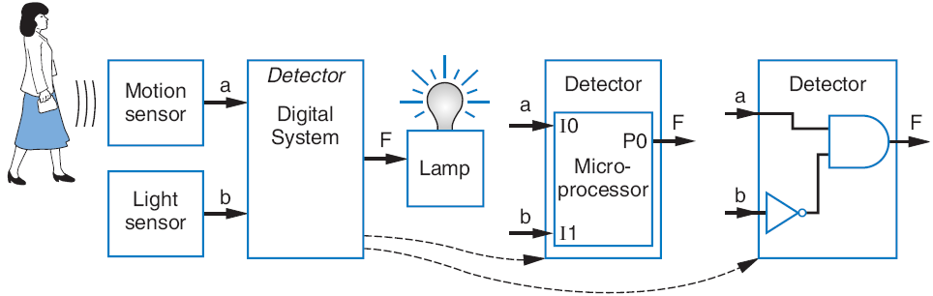
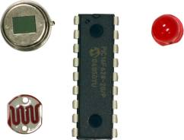
Implementing Digital Systems: Programming Microprocessors Vs. Designing Digital Circuits
1.3
Programmed
microprocessor
Custom designed
digital circuit
Desired motion-at-night detector
Microprocessors a common choice to implement a digital system
  Easy to program
  Cheap (as low as $1)
  Available now
M
I
0
P0
void main()
{
while (1) {
P0 = I0 && !I1;
// F = a and !b,
}
}
r
1
op
I
1
P1
a
r
o
0
c
I
2
P2
I
3
P3
b
1
I
4
P4
0
I
5
P5
1
I
6
P6
F
0
I
7
P7
6:00
7:05
7:06
9:00
9:01
time

Slide 18
Digital Design: When Microprocessors Aren’t Good Enough
With microprocessors so easy, cheap, and available, why design a digital circuit?
  Microprocessor may be too slow
  Or too big, power hungry, or costly
Q: How long for each
implementation option?
Image Sensor
Micro-
processor
(
a
)
(Read,
Compress,
and Store)
5+8+1
=14 sec
Memory
Image Sensor
Read
circuit
Compress
circuit
.1+.5+.8
=1.4 sec
Sample digital camera task execution times (in seconds) on a microprocessor versus a digital circuit:
(
b
)
Memory
Store
circuit
a
Task | Microprocessor | Custom Digital Circuit
Read | 5 | 0.1
Compress | 8 | 0.5
Store | 1 | 0.8
Image Sensor
Read
circuit
Compress
circuit
.1+.5+1
=1.6 sec
(
c
)
Microprocessor
(Store)
Memory
Good
compromise

Slide 19
Chapter Summary
Digital systems surround us
  Inside computers
  Inside huge variety of other electronic devices (embedded systems)
Digital systems use 0s and 1s
  Encoding analog signals to digital can provide many benefits
    e.g., audio -- higher-quality storage/transmission, compression, etc.
  Encoding integers as 0s and 1s: Binary numbers
Microprocessors (themselves digital) can implement many digital systems easily and inexpensively
  But often not good enough -- need custom digital circuits

